Slide 1


Cedric Reichenbach Niko Schwarz
http://scg.unibe.ch/wiki/projects/DoodleDebug

Slide 2
Why?
System.out.println() lacks features
Inspection
Advanced formatting
Images
Colors

Slide 3
Why?
Standard:
contact.AddressBook@737d72cf

Slide 4
Why?
Improved:
-- Addressbook --
Contact: Hannah Montana
La Rambla 55b
7790 New York
---
Contact: Rose Franklin
Down Street 0
8983 Thun
---
Contact: Rose Montana
Hai Ming Way
936 Moskow
[...]

Slide 5
Why?
Debuggers lack features
Comparison between points in time
Customized output

Slide 6
Solution: DoodleDebug
Print an object with Doo.dle(object);
Multiple calls list doodles one below each other
Easily installed as Eclipse plugin
Notes:
-
- Similar to Sysout

Slide 7
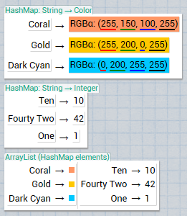
Solution: DoodleDebug
Doo.dle(colorMap)
Doo.dle(intMap)
Doo.dle(mapList)

Slide 8
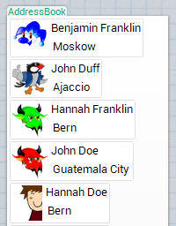
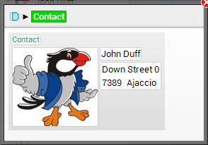
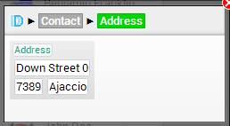
Inspecting Doodles

Slide 9
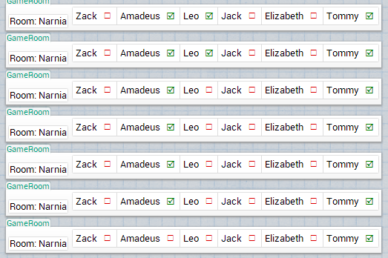
Changes Over Time

Slide 10
Customization
Implement the Doodleable interface
doodleOn(DoodleCanvas) Regular representation
summarizeOn(DoodleCanvas) Simplified representation for nested objects

Slide 11
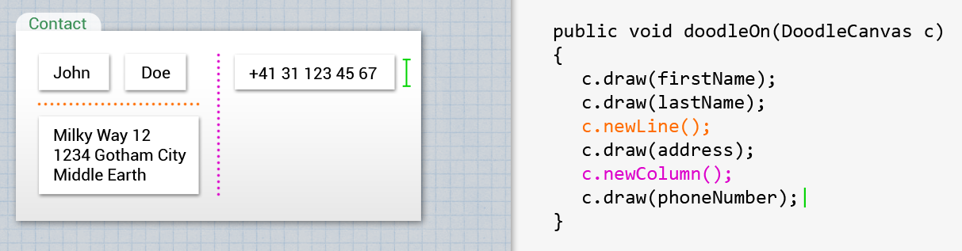
DoodleCanvas

Slide 12
Plugins
Interface RenderingPlugin
For convenience: AbstractPlugin
Define types to be rendered
Generate HTML, CSS

Slide 13
Default Renderings
Most common types included
Primitives and strings
Nulls
Arrays and Collections
Maps
Colors
Images (several types)
Classes

Slide 14
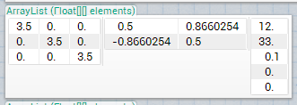
Default Renderings
Objects List fields (if <= 7)
Tables and Matrices Two-dimensional arrays and collections

Slide 15
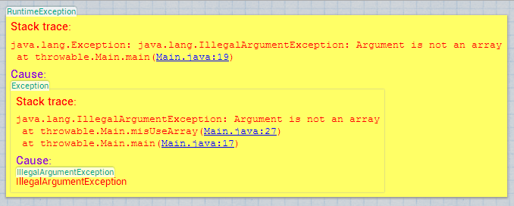
Default Renderings
Throwables With linking to Eclipse editor

Slide 16
Study: Setup
Qualitative
7 subjects
3 problems
Alternatively with or without DoodleDebug
Screen capturing and think-aloud protocol

Slide 17
Study: Outcomes
More efficient debugging
Faster problem detection
Less customization needed
Default doodles should not only use toString() → Listing fields yields better results
Several minor UI problems

Slide 18
Demo
Do not read this

Slide 19
Possible Future Work
Clickable doodles
Debugger integration
Object Diffs

